Slide 1

Unit-4 Syllabus
Introduction
Latches
Flip-Flop
Registers
Counters

Slide 2
Introduction
A sequential circuit consists of a feedback path, and employs some memory elements.
Combinational
outputs
Memory outputs
Memory
elements
Combinational
logic
External inputs
Sequential Circuit = Combinational logic + Memory Elements

Slide 3
Introduction
There are two types of sequential circuits:
Synchronous: outputs change only at specific time
Asynchronous: outputs change at any time
Multivibrator: A class of sequential circuits. They can be:
Bistable (2 stable states)
Monostable or one-shot (1 stable state)
Astable (no stable state)
Bistable logic devices: latches and flip-flops.
Latches and flip-flops differ in the method used for changing their state.

Slide 4
Memory Elements
Memory Element: A device which can remember value indefinitely, or change value on command from its inputs.
Memory element
Q
command
stored value
Characteristic Table:
Command (at time t) | Q(t) | Q(t+1)
Set | X | 1
Reset | X | 0
Memorise / No Change | 0 | 0
 | 1 | 1
Q(t): Current State
Q(t+1) or Q⁺: Next State

Slide 5
Memory Element with Clock
Flip-flops are memory elements that change state on clock signals.
Memory element
Q
command
stored value
clock
Clock is usually a square wave.
Positive pulses
Positive edges
Negative edges

Slide 6
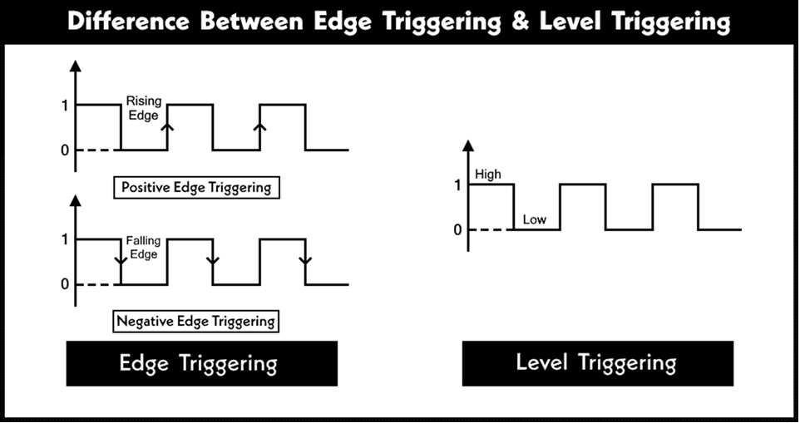
Cont…

Slide 7
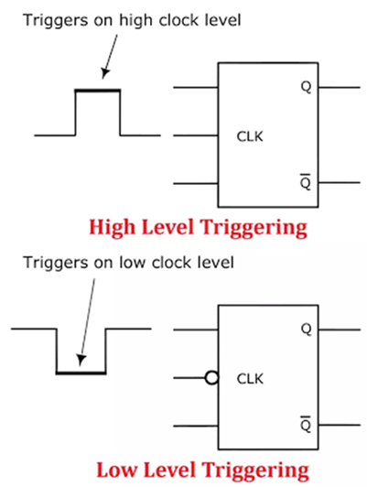
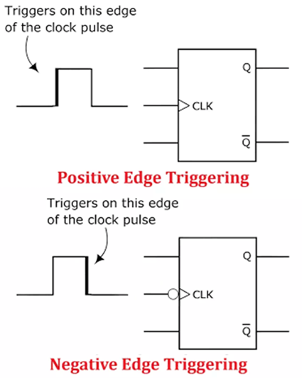
Cont…

Slide 8
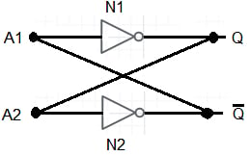
Latch Using NOT Gate
Cross-coupling two NOT circuits N1 and N2.
Connecting each gate’s output to the other gate’s input, we get a feedback combination commonly referred to as a latch.
A latch is a memory element characterized by having only two stable logical states at its output .
The latch is a bistable circuit with two complementary outputs.
Drawback: We can not change the state.

Slide 9
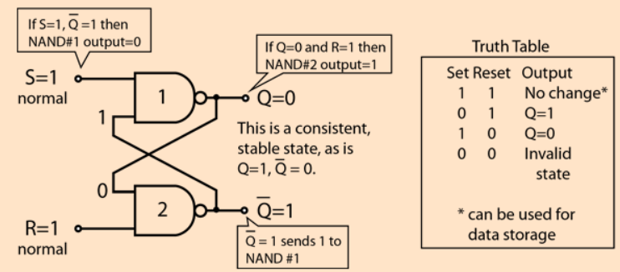
Latch Using NAND Gate
For active-LOW input S'-R' latch (also known as NAND gate latch)

Slide 10
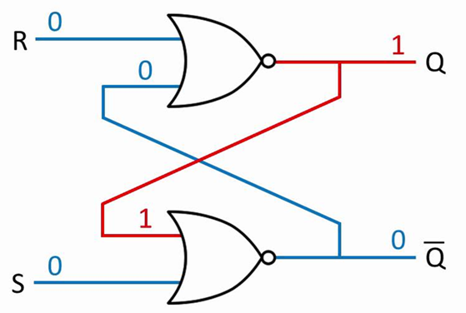
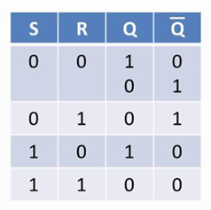
Latch Using NOR Gate
Complementary outputs: Q and Q'.
When Q is HIGH, the latch is in SET state.
When Q is LOW, the latch is in RESET state.
For active-HIGH input S-R latch (also known as NOR gate latch)
Truth Table

Slide 11
Drawbacks
Latch circuits are not suitable in synchronous logic circuits.
When the enable signal is active, the excitation inputs are gated directly to the output Q. Thus, any change in the excitation input immediately causes a change in the latch output.
The problem is solved by using a special timing control signal called a clock to restrict the times at which the states of the memory elements may change.
This leads us to the edge-triggered memory elements called flip-flops.

Slide 12
Cont…

Slide 13
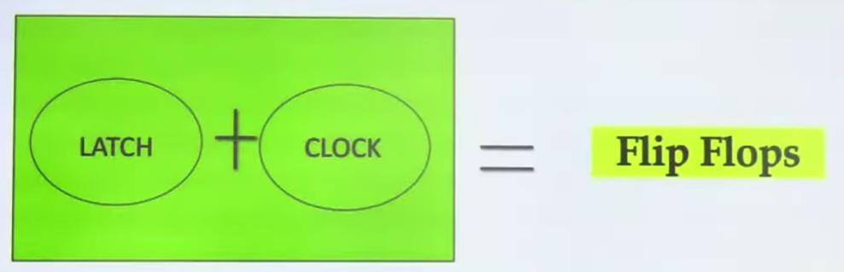
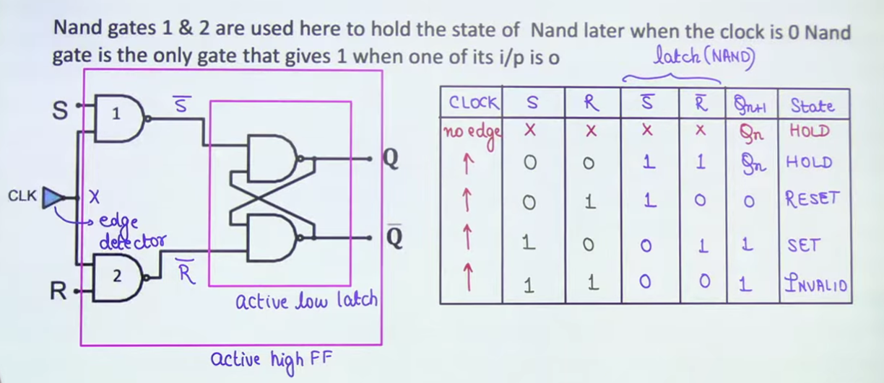
SR Flip-Flop

Slide 14
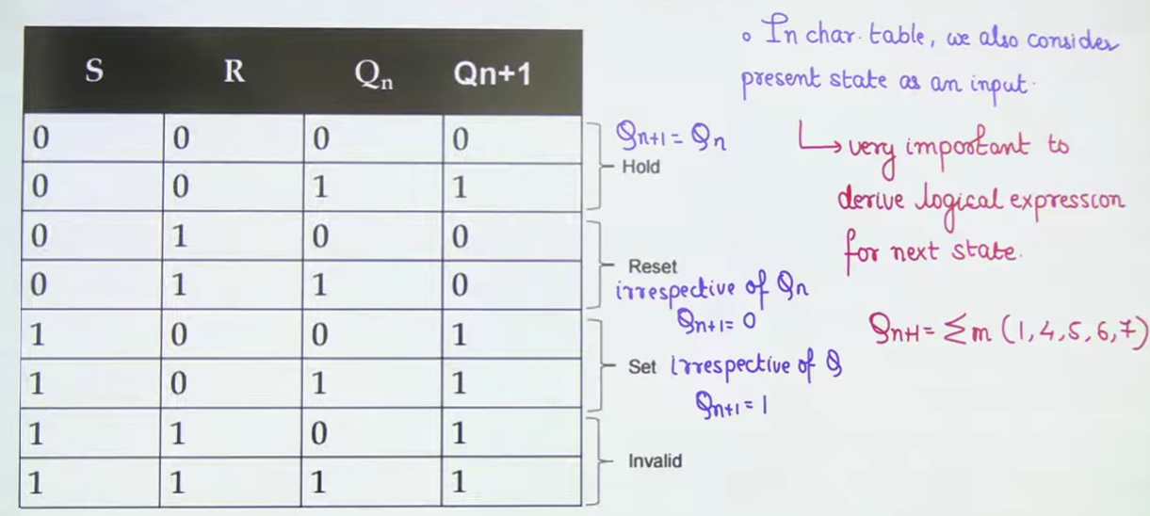

Characteristics Table
Qn+1= Σm(1, 4, 5) + Σd(6, 7)​

Slide 15
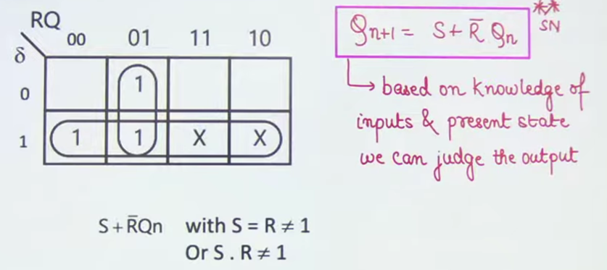
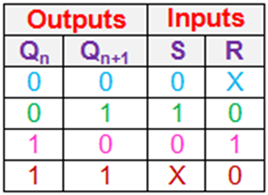
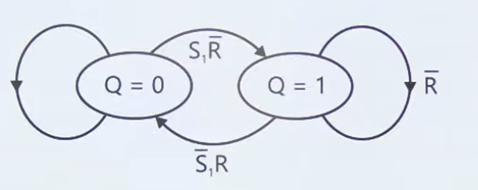
Characteristics Equation
Drawback
4th State is Invalid, to solve this problem, we will use a JK Flip-Flop.
Excitation Table
State Diagram

Slide 16
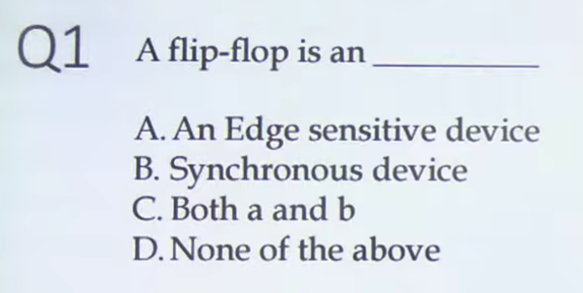
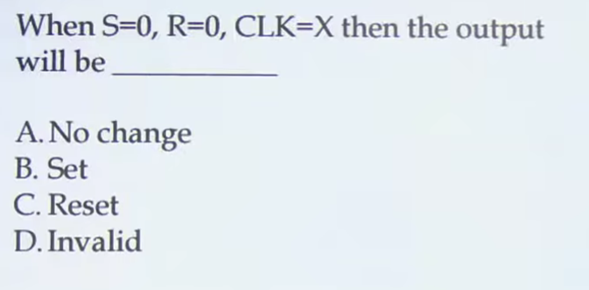
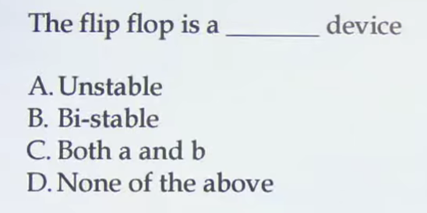
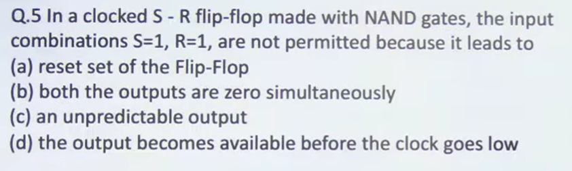
Cont…
Ans-1: C
Ans-2: A
Ans-3: C
Ans-4: C

Slide 17
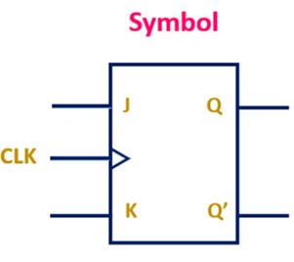
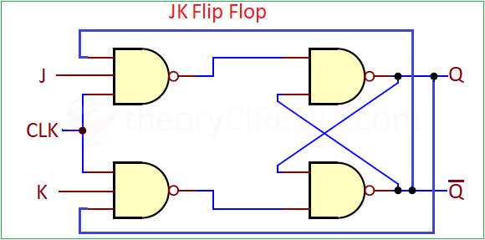
J-K Flip-Flop
A JK flip-flop is a sequential logic circuit used for storing a single bit of information, named after its inventor, Jack Kilby.
It has two inputs, J and K, which, along with a clock signal, determine the next state of the output (Q).
It can set, reset, or toggle its output, making it a versatile building block for counters and other digital circuits.

Slide 18
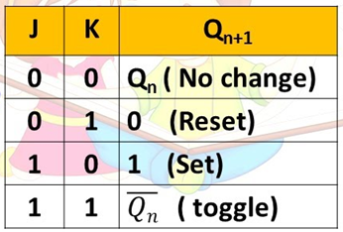
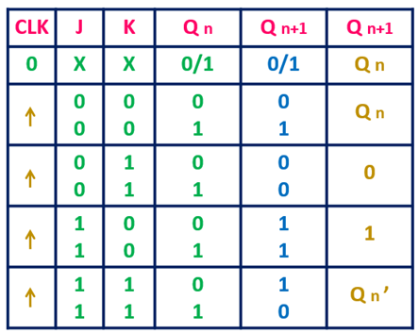
Cont…
Truth Table
Excitation Table
Qn+1= Σm(1, 4, 5, 6)

Slide 19
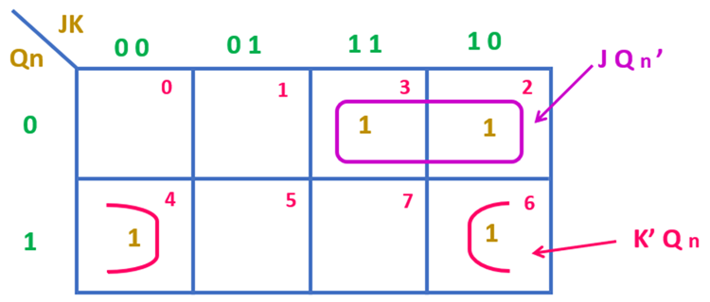

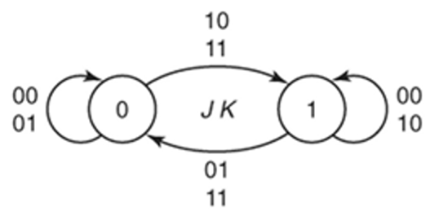
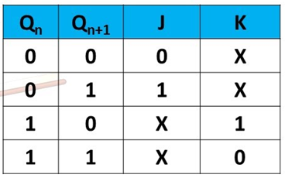
Characteristics Equation
State Diagram
Excitation Table
‘X’ represents that the value of input variable can be either ‘0’ or ‘1’.

Slide 20
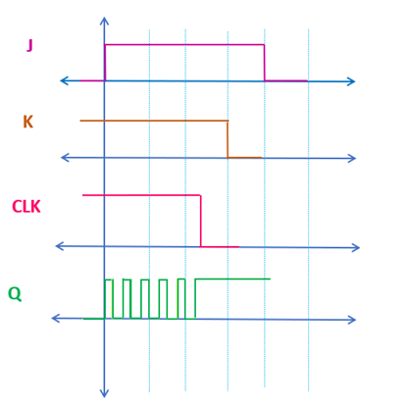
Race-Around Condition
In the level triggered JK Flip-Flop, when J=K=1, the ON time of the clock is more than the propagation delay of the JK Flip-Flop then the output of the flip-flop may toggle continuously between ‘1’ and ‘0’. This condition is known as the Race Around condition.
The issue of Race Around Condition can be resolved using the Master-Slave Flip-Flop.

Slide 21
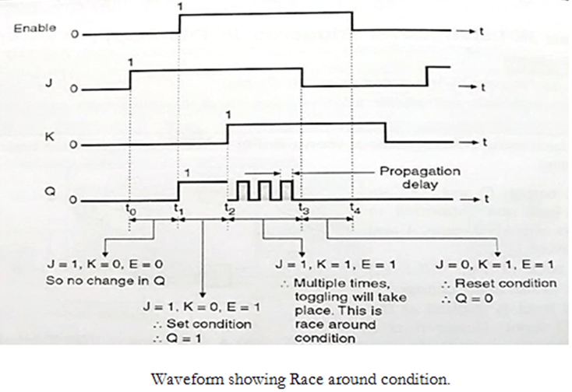
Cont…

Slide 22
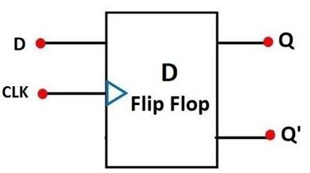
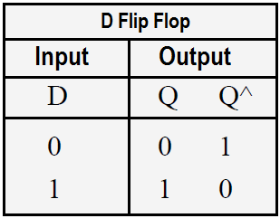
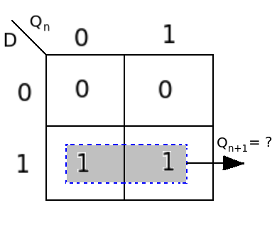
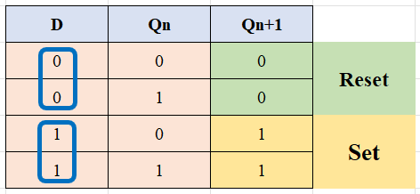
D Flip-Flop
Truth Table
Characteristics Table
Qn+1= D

Slide 23
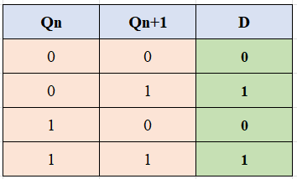
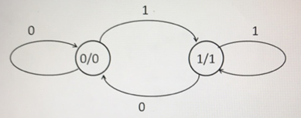
Cont…
Excitation Table
State Diagram

Slide 24
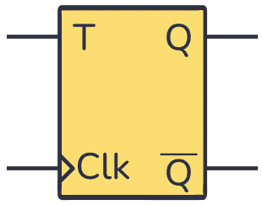
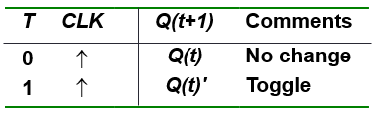
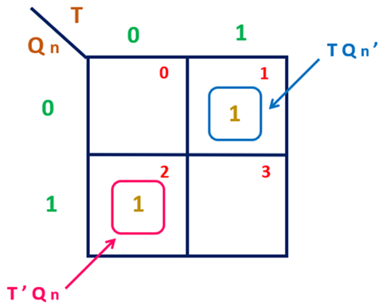
T Flip-FLop
Truth Table
Characteristics Table
Q | T | Q(t+1)
0 | 0 | 0
0 | 1 | 1
1 | 0 | 1
1 | 1 | 0
Q(t+1) = T.Q' + T'.Q

Slide 25
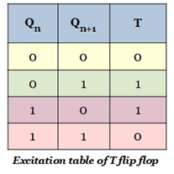
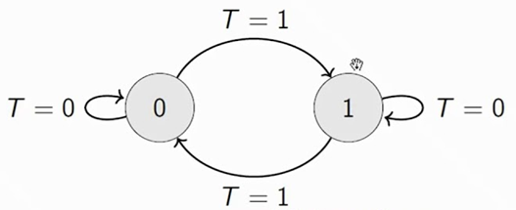
Cont…
Excitation Table
State Diagram

Slide 26
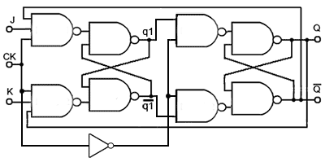
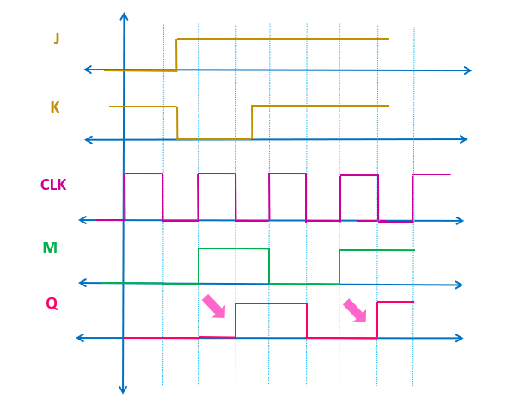
Master Slave JK-Flip-Flop

Slide 27
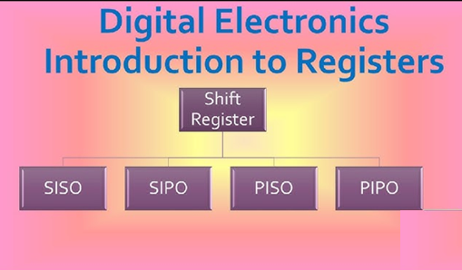
Cont…

Slide 28
Introduction to Register
Flip-flop is a 1 bit memory cell which can be used for storing the digital data.
To increase the storage capacity in terms of number of bits, we have to use a group of flip-flop. Such a group of flip-flop is known as a Register.
The n-bit register will consist of n number of flip-flop and it is capable of storing an n-bit word.
A register is a digital circuit with two basic functions: data storage and data movement.
The information stored within the registers can be transferred with the help of shift registers.
Shift Register is a group of flip flops used to store multiple bits of data.

Slide 29
Cont…
The bits stored in such registers can be made to move within the registers and in/out of the registers by applying clock pulses.
The registers which will shift the bits to left are called "Shift left registers".
The registers which will shift the bits to right are called "Shift right registers".

Slide 30
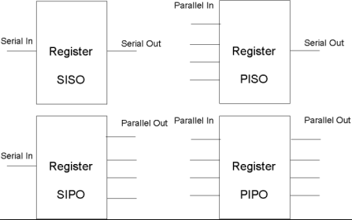
Cont…
Shift Register
A register which is capable of shifting the binary information hold in each Flip-flop to its next Flip-flop in a selected direction (either Left or Right is know as Universal Shift Register) is called shift register.
A shift register which can shift the data in both directions is called a bi-directional shift register.
Type of Shift Register
Serial in and serial out Shift register (SISO).
Serial in and Parallel out Shift register (SIPO).
Parallel in and serial out Shift register (PISO).
Parallel in and Parallel out Shift register (PIPO).

Slide 31
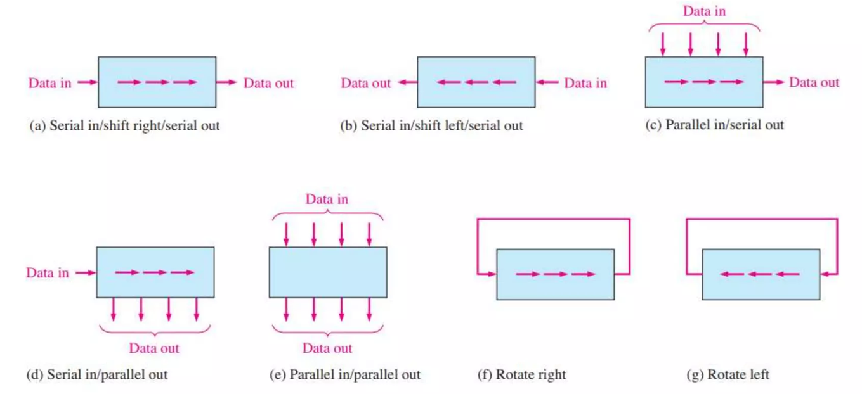
Data Movement in Shift Registers

Slide 32
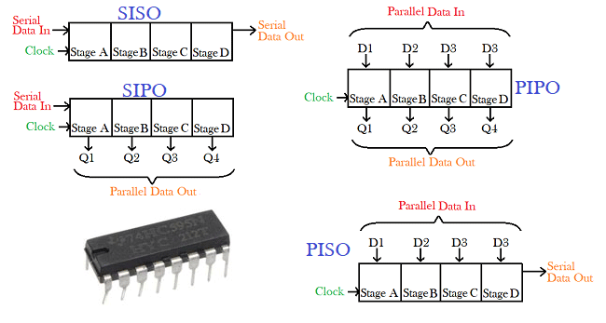
Cont…

Slide 33
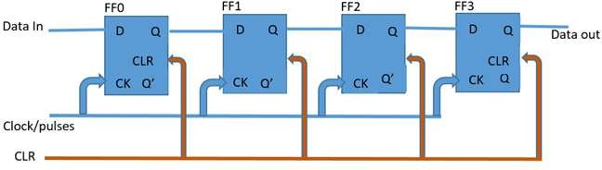
(SISO)
Serial in – Serial out shift registers are shift registers that streams in data serially (one bit per clock cycle) and streams out data too in the same way, one after the other.
A simple serial in – serial Out 4-bit shift register is shown in figure, the register consists of 4 flip flops.
On startup, the shift register is first cleared, forcing the outputs of all flip flops to zero, the input data is then applied to the input serially, one bit at a time.

Slide 34
Cont…
Input: 1101
First clock cycle:
Second clock cycle:
Third clock cycle:
Fourth clock cycle:
FF0 | FF1 | FF2 | FF3
1 | 0 | 0 | 0
FF0 | FF1 | FF2 | FF3
0 | 1 | 0 | 0
FF0 | FF1 | FF2 | FF3
1 | 0 | 1 | 0
FF0 | FF1 | FF2 | FF3
1 | 1 | 0 | 1

Slide 35
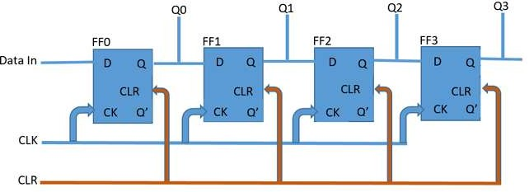
(SIPO)
The second type of shift register we will be considering is the Serial in – Parallel out shift register.
These types of shift registers are used for the conversion of data from serial to parallel.
The data comes in one after the other per clock cycle and can either be shifted and replaced or be read off at each output.
This means when the data is read, each read in bit becomes available simultaneously on their respective output line (Q0 – Q3 for the 4-bit shift register shown below).

Slide 36
Cont…
A table showing how data gets shifted out of serial in – parallel out 4 bit shift register is shown below, with the data in as 1001.
Clear | FF0 | FF1 | FF2 | FF3
1001 | 0 | 0 | 0 | 0
Clk-1 | 1 | 0 | 0 | 0
Clk-2 | 0 | 1 | 0 | 0
Clk-3 | 0 | 0 | 1 | 0
Clk-4 | 1 | 0 | 0 | 1
A good example of the serial in – parallel out shift register is the 74HC164 shift register, which is an 8-bit shift register.

Slide 37
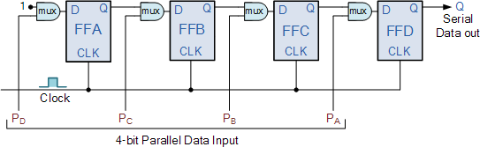
(PISO)
This register can be used to store and shift a 4-bit word, with the write/shift (WS) control input controlling the mode of operation of the shift register.
When the WS control line is low (Write Mode), data can be written and clocked in via D0 to D3.
To shift the data out serially, the WS control line is brought HIGH (Shift mode), the register then shifts the data out on clock input.
A good example of a parallel in – serial out shift register is the 74HC165 8-bit shift register although it can also be operated as a serial in – serial out shift register.

Slide 38
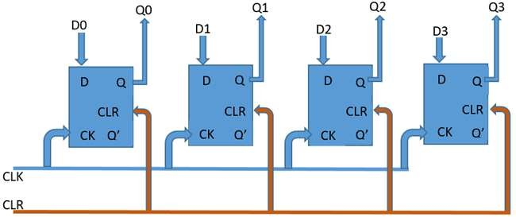
(PIPO)
The input data at each of the input pins from D0 to D3 are read in at the same time when the device is clocked and at the same time, the data read in from each of the inputs is passed out at the corresponding output (from Q0 to Q3).
The 74HC195 shift register is a multipurpose shift register which is capable of working in most of the modes described by all the types we have discussed so far especially as a parallel in – parallel out shift register.

Slide 39
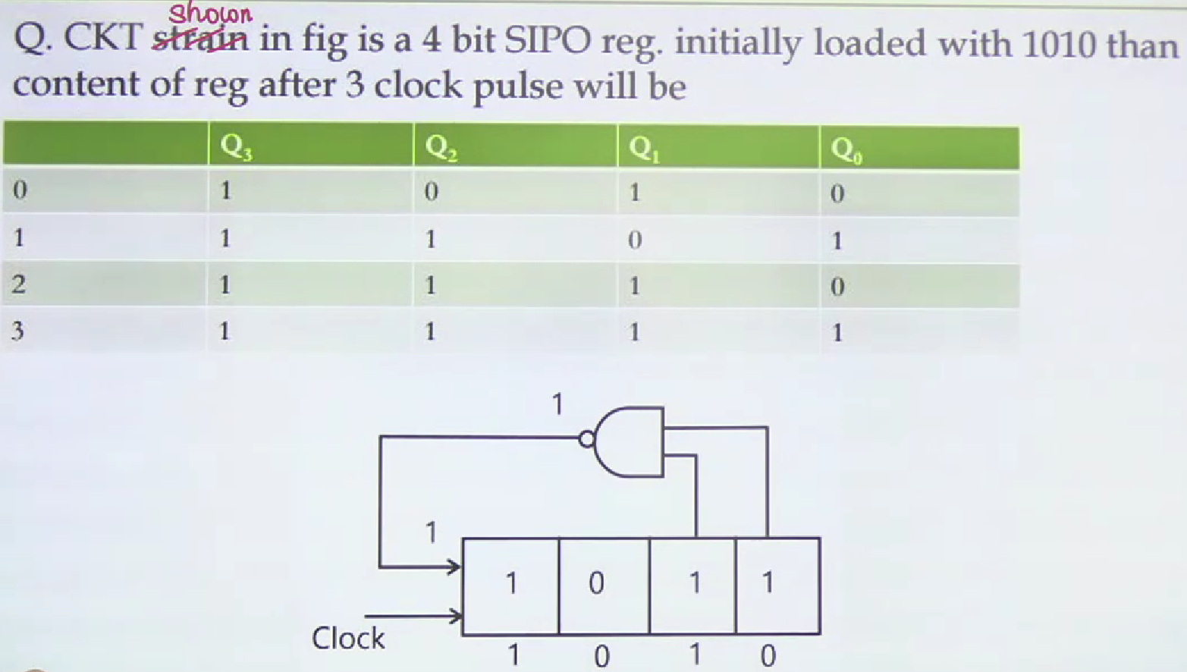
Cont…

Slide 40
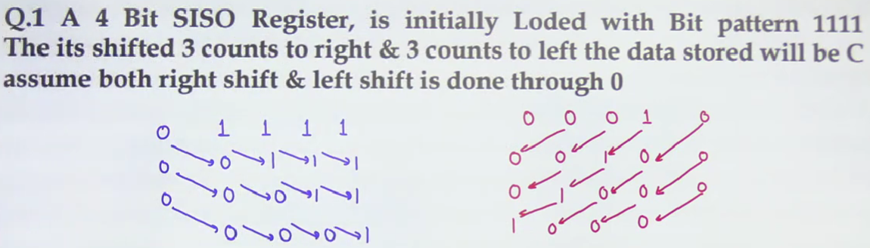
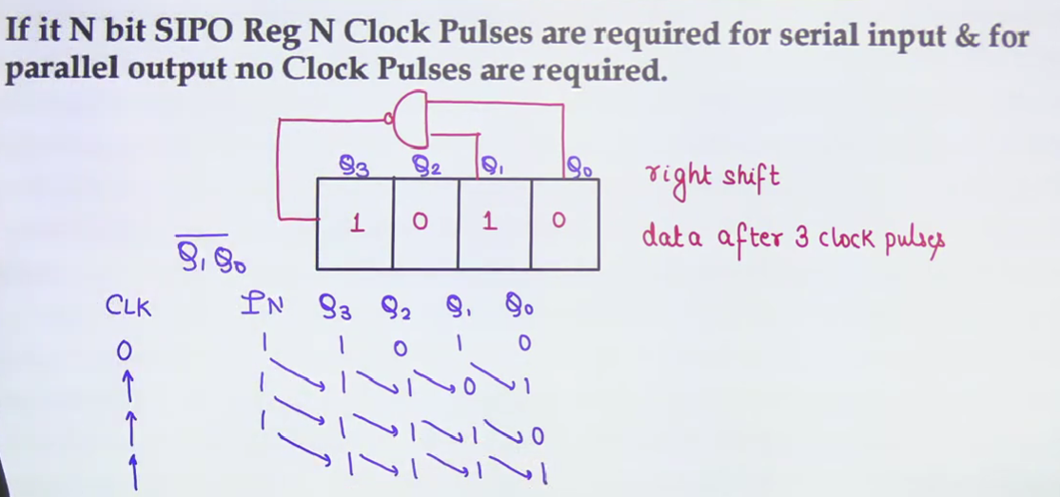
Problems

Slide 41

Cont…

Slide 42

Cont…

Slide 43

Counter
Introduction
Building Blocks
Classification/Types
Asynchronous (Ripple) Counters
Synchronous (Parallel) Counters
Up/Down Counters
Decade (BCD), Ring, and Johnson Counters
Applications

Slide 44
Introduction
A counter is a sequential logic circuit that counts the number of input pulses and generates output sequences in a specific order.
It is widely used in digital systems for applications such as event counting, frequency division, time measurement, and sequence generation.
In simple terms, a counter advances its state (binary value) by one each time it receives a clock pulse.
The number of unique states it can represent depends on the number of flip-flops used.

Slide 45
Cont…
Basic Functions
Counting Pulses: It records the number of clock pulses or external events.
Generating Sequences: Produces a predefined binary or coded sequence (e.g., 000 → 001 → 010 → 011 → …).
Frequency Division: Each flip-flop in the counter divides the input clock frequency by 2, thus a counter can act as a frequency divider.

Slide 46
Building Blocks
Counters are sequential logic circuits, meaning their output depends on both present input and previous states.
They are mainly composed of flip-flops (typically JK, T, or D flip-flops).
Each flip-flop represents one binary bit (0 or 1).
Flip-flops are connected in a specific configuration (either asynchronous/ripple or synchronous) to form the complete counter circuit.

Slide 47
Asynchronous (Ripple) Counters
The counter is called ripple counter because the output of one flip-flop feed to the clock input of another.
In asynchronous circuits we are allowed to play with the clock.
We use trailing edge Flip-Flop. The flip flops respond to negative going clock edge.
T Flip-Flop should have its input connected to 1. D Flip-Flop should have its input connected to the complement of its output.
Each flip flop divides the incoming clock pulse frequency by a factor of 2.

Slide 48


Classifications of Counters
Asynchronous Counters
Only the first flip-flop is clocked by an external clock. All subsequent flip-flops are clocked by the output of the preceding flip-flop.means output of previous flip- flop is connected to clock input of next flip flop.
Asynchronous counters are slower than synchronous counters because of the delay in the transmission of the pulses from flip-flop to flip-flop.
Asynchronous counters are also called ripple- counters because of the way the clock pulse ripples it way through the flip-flops.

Slide 49

Synchronous Counters
All flip-flops are clocked simultaneously by an external clock. Means clock input of all flip flops are connected to same external clock.
Synchronous counters are faster than asynchronous counters because of the simultaneous clocking.
Synchronous counters are an example of state machine design because they have a set of states and a set of transition rules for moving between those states after each clocked event.

Slide 50
Asynchronous Counters
Asynchronous Counter/Ripple counters
can be constructed using several flip flops
consider the following arrangement
with J = K = 1 each flip flop toggles on the falling edge of its clock input

Slide 51

Each stage toggles at half the frequency of the previous stage
acts as a frequency divider
divides frequency by 2^{n} (n is the number of stages)

Slide 52

Application of a frequency divider
Clock generator for a digital watch
– 15-stage counter divides signal from a crystal oscillator by 32,768 to produce a 1 Hz signal to drive stepper motor or digital display

Slide 53

Synchronous (Parallel) Counters
Synchronous Counters are so called because the clock input of all the individual flip-flops within the counter are all clocked together at the same time by the same clock signal.
The clock signal is directly applied to all Flip flops in a parallel sequence.

Slide 54
Synchronous (Parallel) Counters
Synchronous (parallel) counters: the flip-flops are clocked at the same time by a common clock pulse.
We can design these counters using the sequential logic design process
Example: 2-bit synchronous binary counter (using T flip-flops, or JK flip-flops with identical J,K inputs).
Present state
Next state
Flip-flop inputs
00
01
A₁ A₀ |  |  | _{A} + | _{A} + |  | TA₁ TA₀
0 | 0 | 0 |  | 1 | 0 |  | 1
0 | 1 | 1 |  | 0 | 1 |  | 1
1 | 0 | 1 |  | 1 | 0 |  | 1
1
0
11
10
1 1 0 0 1 1

Slide 55



Synchronous (Parallel) Counters
Example: 2-bit synchronous binary counter (using T flip-flops, or JK flip-flops with identical J,K inputs).
Present state |  | Next state |  |  | Flip-flop inputs
A₁ | A₀ |  | + + A₁ A₀ |  |  | TA₁ TA₀
0 | 0 | 0 |  | 1 | 0 |  | 1
0 | 1 | 1 |  | 0 | 1 |  | 1
1 | 0 | 1 |  | 1 | 0 |  | 1
TA = A
1
TA₀ = 1
0
1 1 0 0 1 1
1
J
A₀
J
A₁
Q
Q
C
_{K} Q'
C K
Q'
CLK
Synchronous (Parallel) Counters

Slide 56






Synchronous (Parallel) Counters
CS1104-13
Example: 3-bit synchronous binary counter (using T flip-flops, or JK flip-flops with identical J, K inputs).
Present
state
A₂ A₁ A₀
Next
state
Flip-flop
inputs
TA₂ TA₁ TA₀
_{A} + _{A} + _{A} +
2
1
0
0 | 0 | 0 | 0 | 0 | 1 | 0 |  | 0 | 1
0 | 0 | 1 | 0 | 1 | 0 | 0 |  | 1 | 1
0 | 1 | 0 | 0 | 1 | 1 | 0 |  | 0 | 1
0 | 1 | 1 | 1 | 0 | 0 | 1 |  | 1 | 1
1 | 0 | 0 | 1 | 0 | 1 | 0 |  | 0 | 1
1 | 0 | 1 | 1 | 1 | 0 | 0 |  | 1 | 1
1 | 1 | 0 | 1 | 1 | 1 | 0 |  | 0 | 1
1 | 1 | 1 | 0 | 0 | 0 | 1 |  | 1 | 1
 |  | A₁ |  |  |  |  | A₁ |  |  | A₁
 |  | 1
 |  | 1
 | 1 | 1
 | 1 | 1
1 | 1 | 1 | 1
1 | 1 | 1 | 1
A₂
A₂
A₂
A₀
TA₂ = A₁.A₀
A₀
TA₁ = A₀
A₀
TA₀ = 1
Synchronous (Parallel) Counters

Slide 57


Synchronous (Parallel) Counters
Example: 3-bit synchronous binary counter (cont’d).
TA₂ = A₁.A₀ TA₁ = A₀ TA₀ = 1
A₂
A₁
A₀
Q K
Q K
Q K
J
J
J
CP
1
Synchronous (Parallel) Counters

Slide 58


Synchronous (Parallel) Counters
Note that in a binary counter, the n^{th} bit (shown underlined) is always complemented whenever
011…11 → 100…00
or 111…11 → 000…00
Hence, X_{n} is complemented whenever X_{n-1}X_{n-2} ... X₁X₀ = 11…11.
As a result, if T flip-flops are used, then TX_{n} = X_{n-1} . X_{n-2} . ... . X₁ . X₀
Synchronous (Parallel) Counters

Slide 59


